Slide 1

Monika Suresh Gautam
Hackathon Project

Slide 2
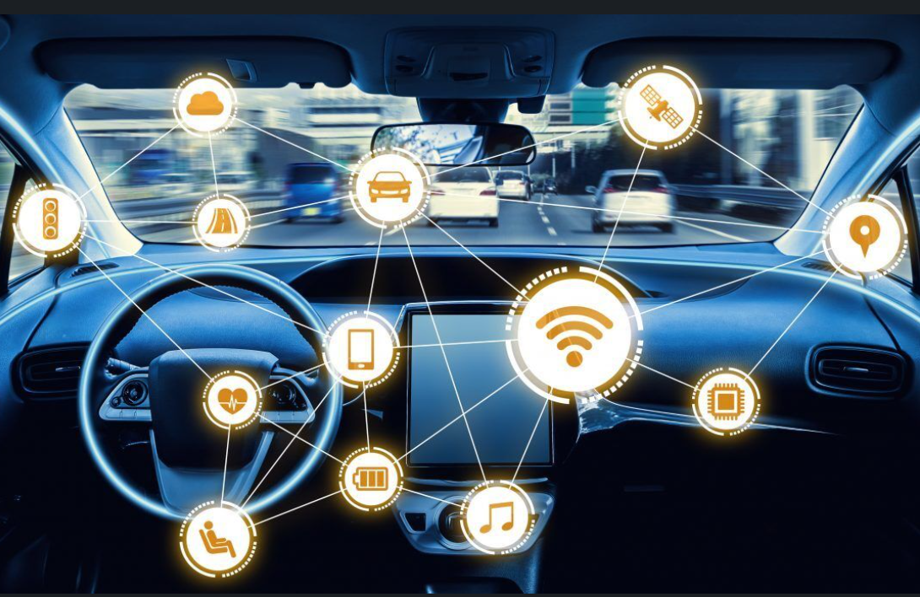
Use of Deep Learning in Automotive Cybersecurity

Slide 3

Contents
Introduction to the Problem
Current State of Cybersecurity in Automotive
Challenges and Types of threats
Proposed solution
Dataset
Model
Results
Conclusion

Slide 4
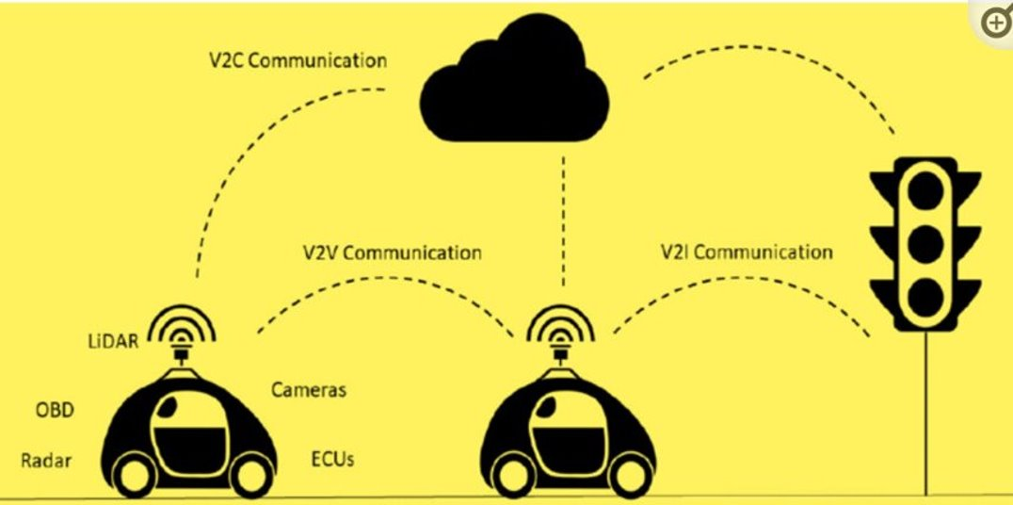
Introduction to the problem
With the rapid development of automobile manufacturing and the Internet of Things technology, the autonomous vehicle network has become intelligent and more established.
The autonomous vehicle provides many facilities by connecting the automobile to satellite navigation or entertaining systems.
Cars providing these facilities face the risk of remote attacks due to the connection of the intelligent automatic vehicle network to the Internet for remote accessing.
With increased V2V and V2I communication, Cybersecurity is required to secure the system against cyberattacks that could impact
its effectiveness, whether electronically
or physically.

Slide 5

In recent years, there have been several high-profile cyber-attacks on automotive systems, including the Jeep Cherokee hack in 2015 and the Tesla Model S hack in 2016.
These attacks demonstrate the urgent need for improved cybersecurity measures in the automotive industry.
In the USA, Google started examining driverless vehicles in 2009 with road tests of CAVs. Tesla has designed on-road CAV driving vehicles and distributed them for commercial purposes

Slide 6
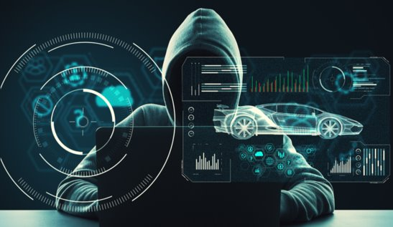
Current State of Cybersecurity in Automotive
The automotive industry has become a prime target for cybercriminals due to the proliferation of connected vehicles.
According to a recent report by Upstream Security, there was a staggering 99% increase in automotive cybersecurity incidents between 2019 and 2020.
In 2022, automotive API attacks surged by 380%, comprising 12% of total incidents, despite OEMs’ advanced cybersecurity measures.
These automotive cybersecurity threats encompass a wide range of attacks, including remote exploitation, data breaches, ransomware, and even physical manipulation of vehicle components.

Slide 7
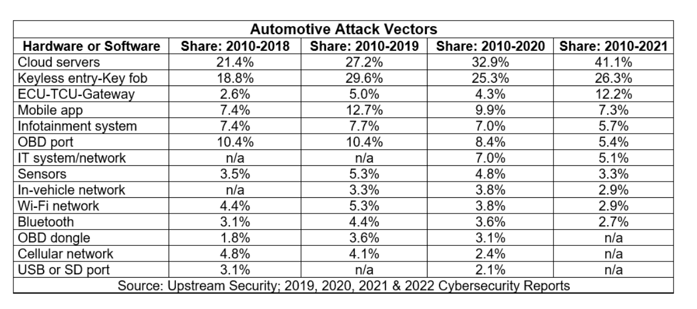
Toyota’s Japan plants shut down in Feb 2022 after a supplier was hit by a severe cyberattack, 28 production lines in 14 plants were suspended, impacting 10,000 cars (5% of monthly output).

Slide 8
Benefits of Deep Learning and AI in Cybersecurity
Automated detection and response to cyber threats
Improved accuracy and speed of threat identification
Ability to analyze large amounts of data in real-time
Applications of Deep Learning and AI in Cybersecurity
Intrusion detection and prevention systems
Malware detection and analysis
Vulnerability assessment and management
Case Studies of Successful Implementation
BMW uses deep learning to detect and prevent cyber-attacks on their vehicles. Their system analyzes data from various sensors and components to identify abnormal behavior and take immediate action to prevent damage.
Tesla's Autopilot system uses AI to improve the safety and security of their vehicles. The system analyzes data from cameras, radar, and ultrasonic sensors to detect potential dangers and take corrective actions.

Slide 9

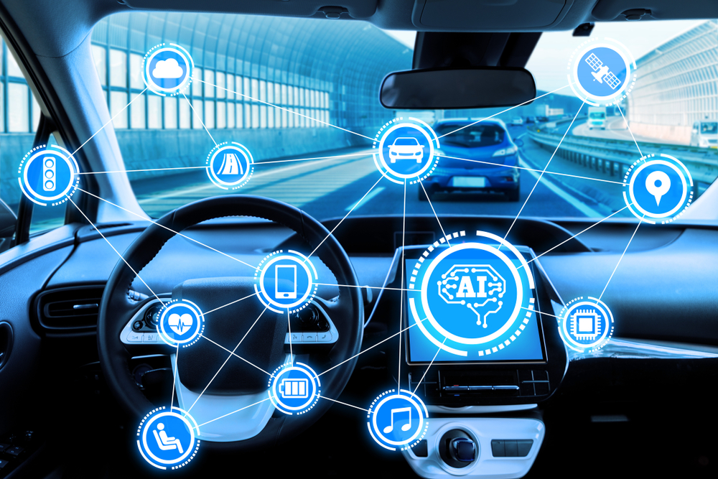
Challenges
Increased connectivity and vehicle vulnerabilities
Potential risks and consequences of cyber attacks
Ransomware & data breaches
DDoS/ Hacking / Botnets

Slide 10
Types of threats
Attack free
The normal traffic data in CAN bus.
The CAN IDs send the data into the CAN Bus to inform the current status of the embedded sensor and devices for assisting with operating the vehicle.
Flooding attack
When CAN messages transmitted from several different sender ECU nodes are simultaneously transmitted to a receiver ECU node, the values of the CAN IDs are compared to determine the priority of the CAN message to be accepted first. The lower the value of a CAN ID is the higher its priority.
This attack can limit the communications among ECU nodes and disrupt normal driving.
Fuzzy attack
For the fuzzy attack, we randomly generated CAN message.
This process was conducted for both the ID field and the Data field.
The randomly generated CAN ID ranged from 0×000 to 0×7FF and included both CAN IDs originally extracted from the vehicle and CAN IDs which were not.
Spoofing Attack
The spoofing attack is defined as a compromised ECU sending CAN data frames with a modified (forged) ID field that intends to masquerade as data or instruction from a legitimate source ECU node.

Slide 11
Proposed solution
To solve the problem I have utilized LSTM (Long- Short Term Model)
The central role of an LSTM model is held by a memory cell known as a ‘cell state’ that maintains its state over time. The cell state is the horizontal line that runs through the top of the below diagram. It can be visualized as a conveyor belt through which information just flows, unchanged.

Slide 12
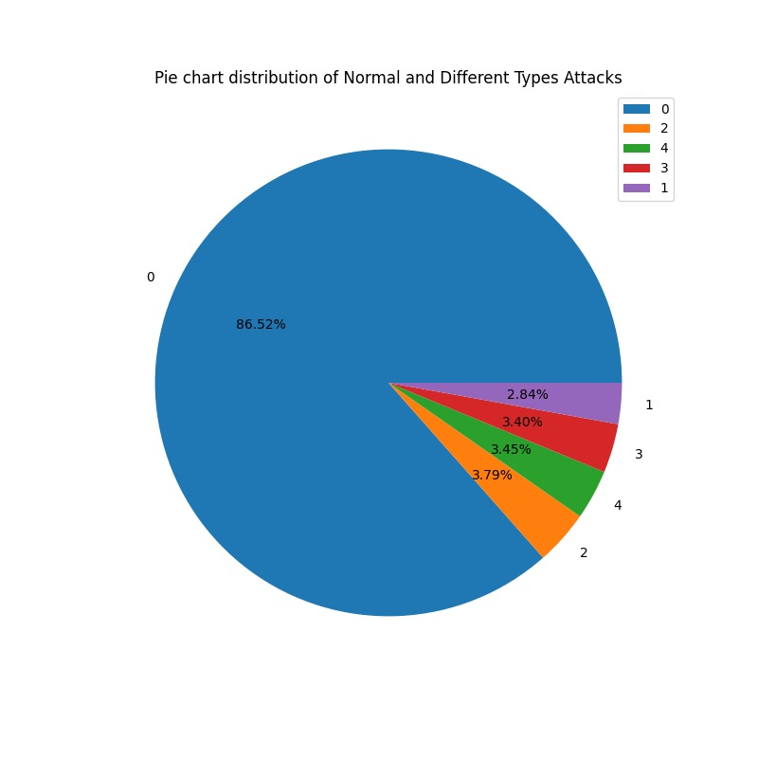
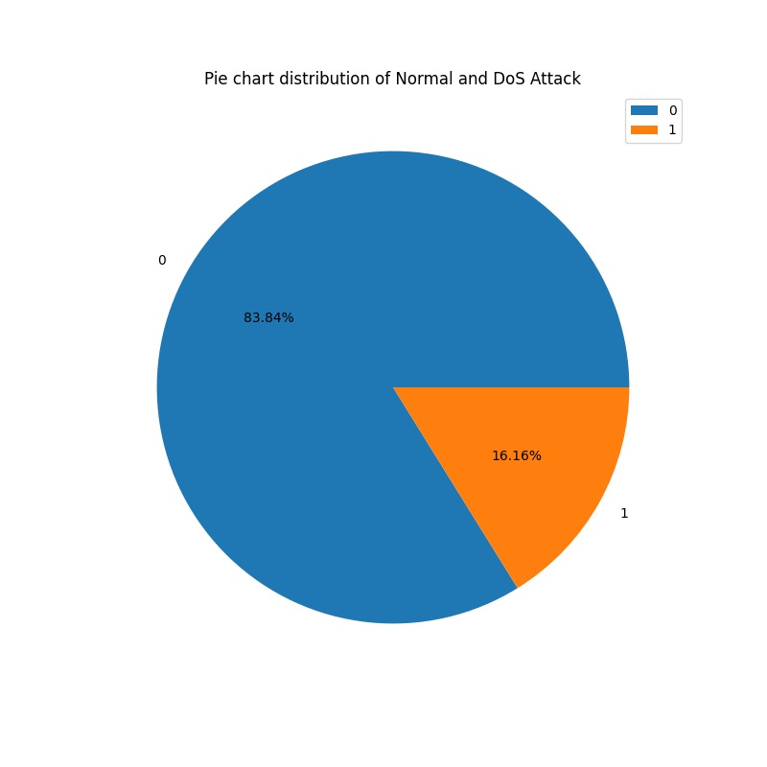
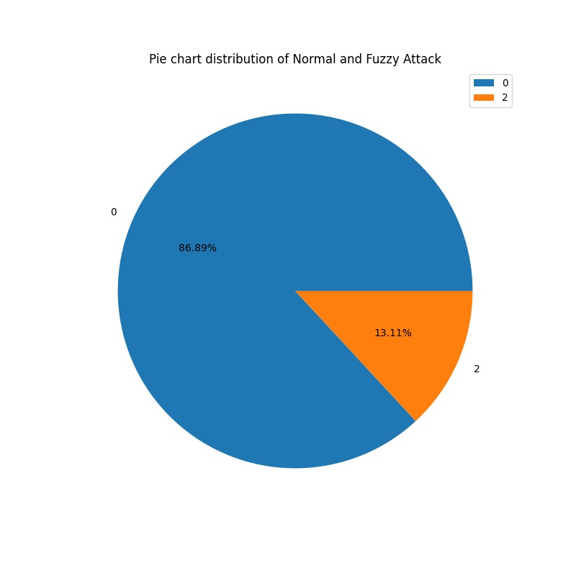

Dataset
https://ocslab.hksecurity.net/Datasets/car-hacking-dataset

Slide 13
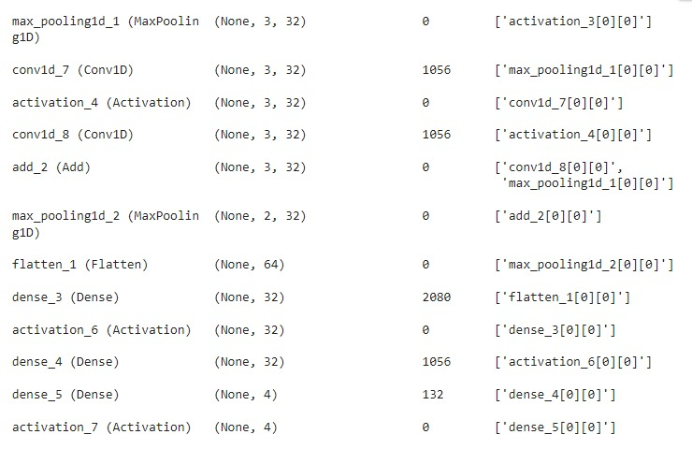
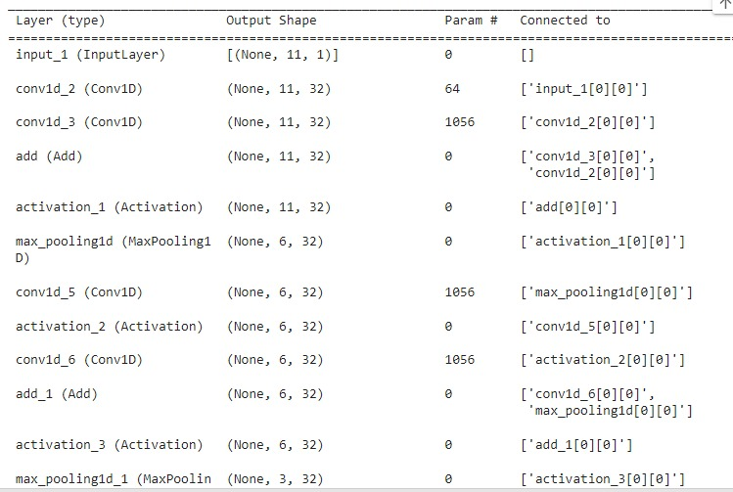
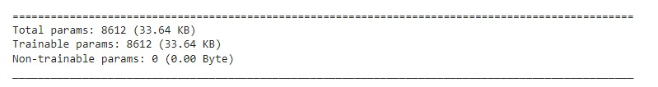
Model

Slide 14
Result

Slide 15
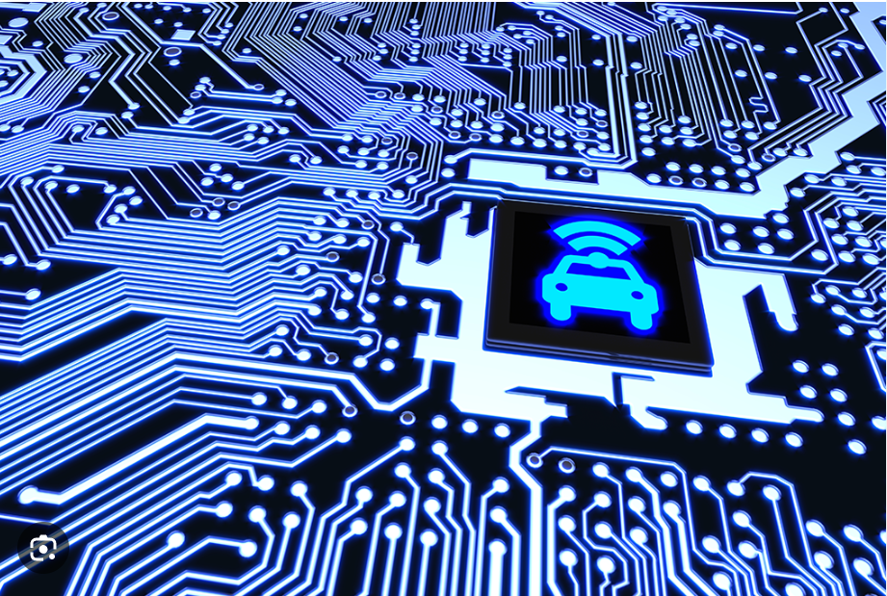
Conclusion
The interconnectivity of vehicles exposes them to a wide range of cyber-attacks, posing huge risks.
By recognizing the importance of cybersecurity, the automotive industry can proactively address the growing threats it faces.
Looking to the future, artificial intelligence and machine learning will play an increasingly significant role in enhancing cybersecurity capabilities.

Slide 16
References:
https://www.linkedin.com/pulse/how-cyber-security-threats-impacting-automotive-industry-1f/
https://www.mdpi.com/2624-6511/3/1/2
https://ocslab.hksecurity.net/Datasets/datachallenge2019/car
https://www.cyient.com/blog/software-defined-automotive-cybersecurity-more-than-in-vehicle-and-cloud
https://researchgate.net/publication/361952737_Using_Deep_Learning_Networks_to_Identify_Cyber_Attacks_on_Intrusion_Detection_for_In-Vehicle_Networks
https://www.ncbi.nlm.nih.gov/pmc/articles/PMC8749531/
https://intellipaat.com/blog/what-is-lstm/#:~:text=LSTM%20Explained,-Now%2C%20let's%20understand&text=It%20is%20a%20variety%20of,data%20points%20such%20as%20images.

